Slide 1



APPLIED DATA SCIENCE CAPSTONE
Predicting SpaceX Falcon 9 first-stage booster reuse outcomes using a custom REST API pipeline, web scraping, geospatial analytics, interactive dashboards, and supervised classification machine learning models.
Lahcen Mokhtar AMROUNE
|
July 2026
https://github.com/LahcenAmroune/Applied-Data-Science-Capstone

Slide 2

OUTLINE
Executive Summary
Intoduction
Methodology
Results
Discussion
Conclusion

Slide 3
Executive Summary & Overview
This project evaluates the predictability of SpaceX Falcon 9 first-stage booster landings to analyze commercial launch economics and competitive pricing dynamics. By successfully recovering first-stage boosters—which represent over 60% of total rocket production costs—SpaceX offers launch prices near $62M, drastically undercutting traditional industry benchmarks of $165M+.
Using an end-to-end data pipeline combining REST API collection, web scraping, exploratory data analysis (EDA), and interactive geospatial dashboards, we examined how payload mass, orbit selection, and launch pad geography influence booster recovery. Machine learning models were benchmarked to predict landing success, with the Decision Tree classifier emerging as the top-performing algorithm. These predictive capabilities enable competitors and launch customers to assess mission recovery risk and optimize commercial bidding strategies.

Slide 4
Introduction
This capstone project aims to develop a predictive model capable of determining whether the first stage of a SpaceX Falcon 9 rocket will land successfully.
SpaceX currently advertises Falcon 9 launches at a cost of $62 million, significantly undercutting competitors who charge upwards of $165 million per launch. This substantial cost advantage is primarily driven by SpaceX’s ability to recover and reuse the first-stage booster. Accurately predicting landing outcomes therefore provides critical insight into launch costs, enabling potential competitors to better assess pricing strategies when bidding against SpaceX.
It should be noted that not all unsuccessful landings are failures in the operational sense; some are intentional, such as controlled oceanic landings performed for mission-specific reasons.
This project seeks to build a predictive model that uses launch parameters like payload mass, orbit type, and site location to forecast whether the Falcon 9 booster will successfully touch down.

Slide 5
Methodology
Data collection methodology :
Retrieval and consolidation from multiple SpaceX API endponts
Web scaping tabular data from Wikipedia
Perform data wrangling
Extracted relevant records
Flattened fields and resolved missing values endpoints
Perform exploratory data analysis (EDA) using visualization and SQL
Visualize variable relationships
Look at the data in aggregate
Perform interactive visual analytics using Folium and Plotly Dash
Mark all launch sites on a map
Mark successful and failed launches
Calculate distances to proximate locations
Provide for interactive exploration of the data
Perform predictive analysis using classification models 7
Build, evaluate, and compare several predictive classification models

Slide 6
Data Collection
Data was collected using a combination of retrieval techiniques:
HTTP requests, SpaceX API :
Initial lauch data was obtained from : /v4/launches/past
Additional data was backfilled from:
/V4/rockests
/V4/launchpads
/V4/playloads
/V4/cores
Tabular data from the : List of Falcon 9 and Falcon Heavy launches – Wikipedia page.

Slide 7
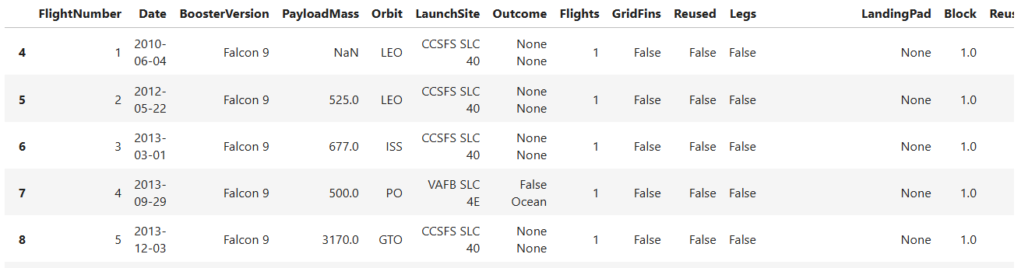
Data collection, wrangling and formating
The primary data source for this project was the SpaceX API, provided through the Coursera platform at https://api.spacexdata.com/v4/rockets/. We utilized this API to retrieve launch records; however, as our analysis focuses exclusively on Falcon 9 missions, the data was filtered accordingly to include only Falcon 9 launches.
During the data cleaning process, missing values were handled by imputing the mean of the respective columns. After preprocessing, the final cleaned dataset comprised 90 launch records (rows) and 17 features (columns). A preview of the dataset following cleaning is presented below.
github.com/LahcenAmroune/Applied-Data-Science-Capstone

Slide 8
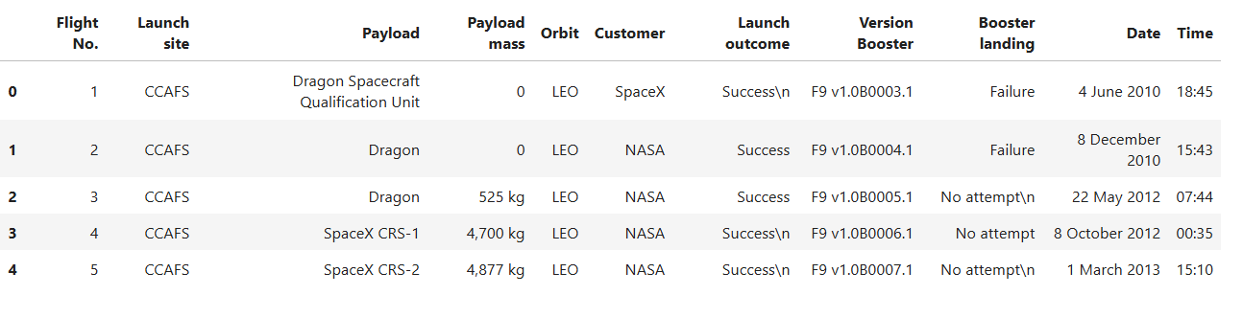
Data collection, wrangling and formating
In addition to the API data, we also collected information through web scraping. The source used was the Wikipedia page dedicated to Falcon 9 and Falcon Heavy launches, accessible at the following URL:
https://en.wikipedia.org/w/index.php?title=list_of_falcon_9_and_falcon_heavy_launches&oldid=1027686922
This page was specifically chosen because it contains data exclusively related to Falcon 9 launches, making it directly relevant to our analysis. After extracting and processing the scraped data, we obtained a cleaned dataset consisting of 121 launch records (rows) and 11 features (columns).
A sample of the first few entries from this dataset is shown in the table below.
Let me know if you need any adjustments!

Slide 9
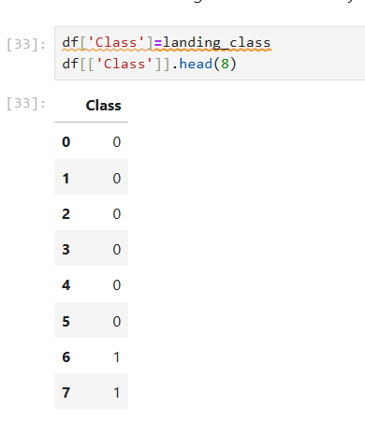
Data collection, wrangling and formating
This phase was structured around two main goals: uncovering patterns in the launch data, and preparing the target label for supervised learning.
To accomplish this, we followed a systematic process:
Data Assessment – We began by checking for missing values, calculating the percentage of nulls per attribute, and classifying each column as either numerical or categorical.
Distribution Analysis – We then examined the spread of launches across different launch sites and orbit types to understand the composition of the dataset.
Outcome Preparation – Finally, we explored mission outcomes, grouped them into binary categories (success or failure), and stored the result as a "Class" label, which served as the target variable for training our models.
https://github.com/LahcenAmroune/Applied-Data-Science-Capstone/blob/main/jupyter-labs-spacex-data-collection-api.ipynb
https://github.com/LahcenAmroune/Applied-Data-Science-Capstone/blob/main/jupyter-labs-webscraping.ipynb
https://github.com/LahcenAmroune/Applied-Data-Science-Capstone/blob/main/labs-jupyter-spacex-Data%20wrangling.ipynb

Slide 10
Exploratory Data Analysis (EDA)
Data Processing & Analysis
Libraries: Pandas, NumPy, and SQL.
Pandas/NumPy: Used for initial data exploration, generating summary statistics on launch sites, orbit types, and mission outcomes.
SQL: Employed for targeted queries to extract specific insights, such as unique launch sites, total payload mass for NASA (CRS) missions, and average payload mass for the F9 v1.1 booster.
Data Visualization
Libraries: Matplotlib, Seaborn, Folium, and Dash.
Matplotlib/Seaborn: Create static charts (scatter, bar, line) to visualize relationships between flight numbers, payload mass, launch sites, and orbit success rates.
Folium: Generates interactive maps to pinpoint launch sites, visualize mission outcomes (success/failure) per site, and measure distances to nearby infrastructure (cities, railways, highways).
Dash: Powers an interactive dashboard featuring dropdowns and sliders, allowing users to explore total successful launches per site and the correlation between payload mass and mission outcome.

Slide 11
Exploratory Data Analysis (EDA)
Machine Learning Prediction
Library: Scikit-learn.
Process: The workflow includes data standardization and splitting data into training/testing sets.
Models: Implements Logistic Regression, SVM, Decision Trees, and KNN.
Evaluation: Models are tuned via hyperparameter optimization and assessed using accuracy scores and confusion matrices.

Slide 12
EDA with SQL
SQL Queries :
Show each unique launch site
Show 5 records where launch site names begin with 'CCA'
Display the total payload mass carried by boosters launched by 'NASA (CRS)'
Display the average payload mass carried by the v1.1 Falcon 9 booster
List the date of the first successful ground landing outcome
List the booster versions with successful outcomes landing on the drone ship with payloads between 4000kg and 6000kg.
List the number of successful and failed mission outcomes
List all of the booster versions that carried the max payload mass
List the month name, outcome, booster version, and launch site for missions with failure outcomes landing on a drone ship in 2015.
Show the distribution of outcomes between June 4th, 2010 and March 20th, 2017
https://github.com/LahcenAmroune/Applied-Data-Science-Capstone/blob/main/jupyter-labs-eda-sql-coursera_sqllite.ipynb

Slide 13

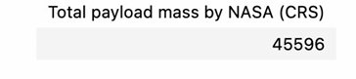
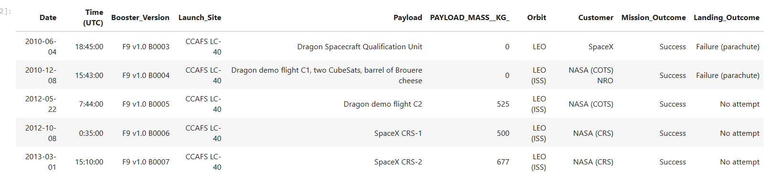
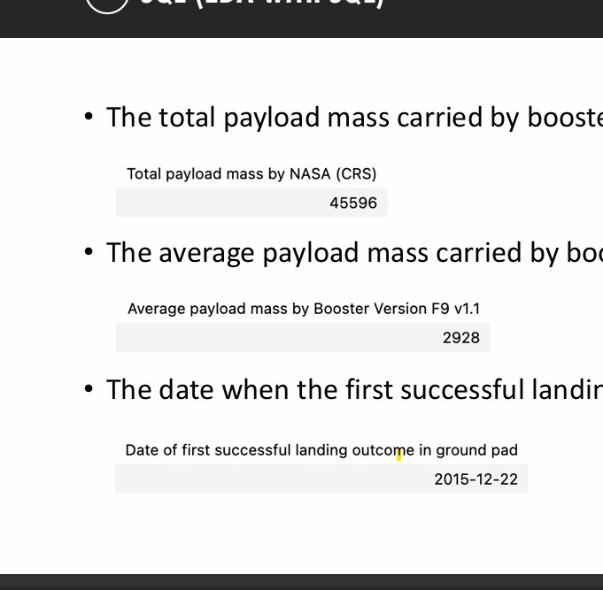
EDA with SQL
Total payload mass transported by boosters for NASA (CRS) missions
Retrieving the names of all unique launch sites involved in the SpaceX missions to understand how many different sites were used
Filtering the data to show only those launch sites that begin with 'CCA' revealing 5 specific records matching this condition
• Theaverage payload mass carried by booster version F9 v1.1

Slide 14
EDA with SQL
Total payload mass transported by boosters for NASA (CRS) missions
Retrieving the names of all unique launch sites involved in the SpaceX missions to understand how many different sites were used
Filtering the data to show only those launch sites that begin with 'CCA' revealing 5 specific records matching this condition
• Theaverage payload mass carried by booster version F9 v1.1

Slide 15

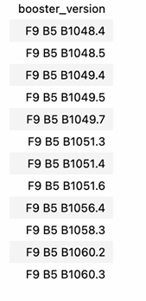
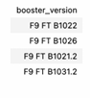
EDA with SQL
• Thedate whenthe first successful landing outcome in ground pad was achieved
• The total number of successful and failure mission outcomes
• The names of the boosters which have success in drone ship and have payload mass greater than 4000 but less than 6000
The names of the booster versions which have carried the maximum payload mass

Slide 16
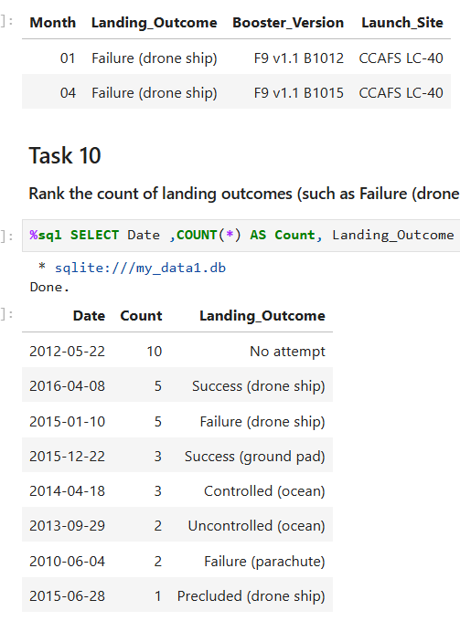
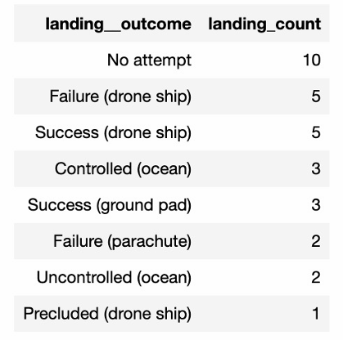
EDA with SQL
The failed landing outcomes in drone ship, their booster versions, and launch site names for in year 2015
The count of landing outcomes between the date 2010-06-04 and 2017-03-20, in descending order

Slide 17
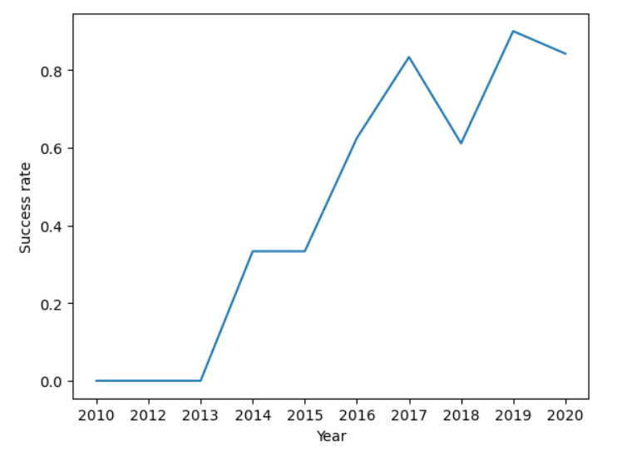
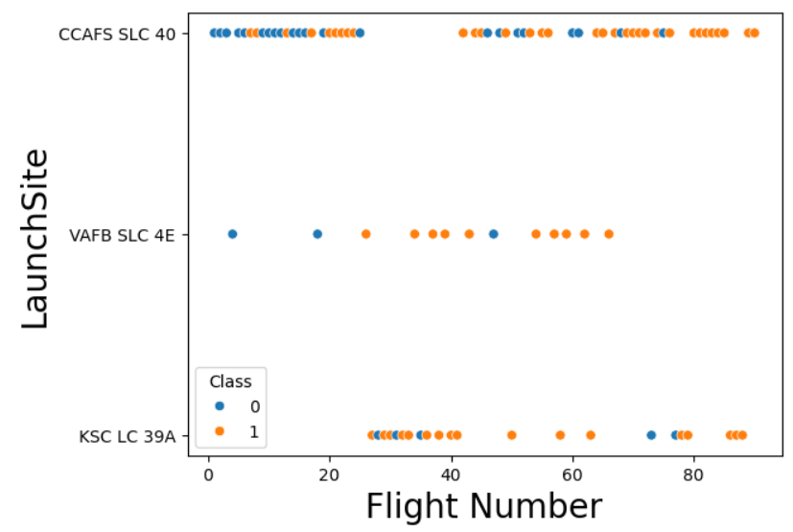
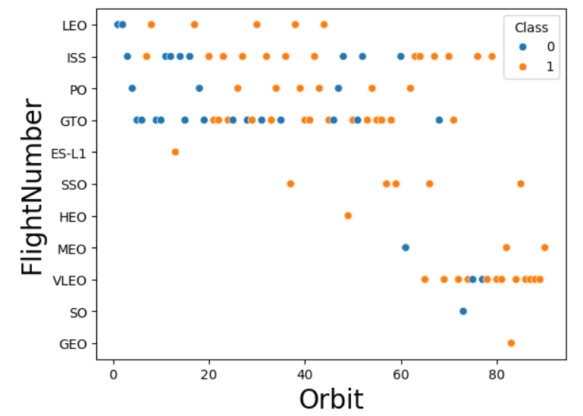
EDA with Data Visualization
Smploy data visualization techniques to evaluate the contribution of individual features and their impact on target outcomes.:
Visualize the relationship between Flight Number and Launch Site
Visualize the relationship between Payload and Launch Site
Visualize the relationship between success rate of each orbit type
Visualize the relationship between FlightNumber and Orbit type
Visualize the relationship between Payload and Orbit type
Visualize the launch success yearly trend

Slide 18
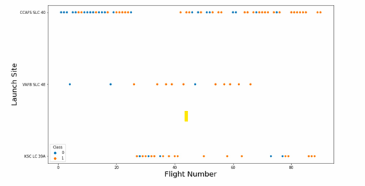
EDA with Data Visualization
• The relationship between flight number and launch site

Slide 19
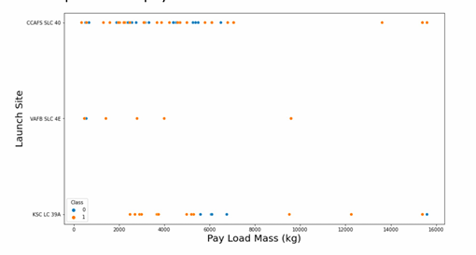
EDA with Data Visualization
• The relationship between payload mass and launch site

Slide 20
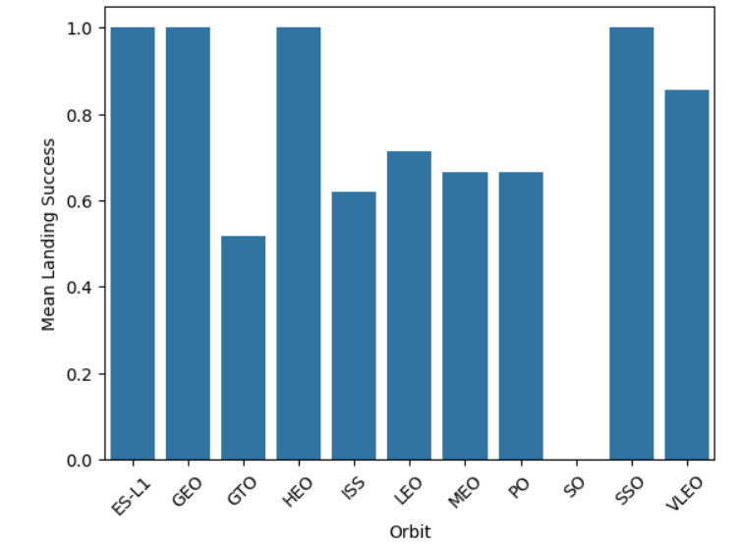
EDA with Data Visualization
• The relationship between success rate and orbit type

Slide 21
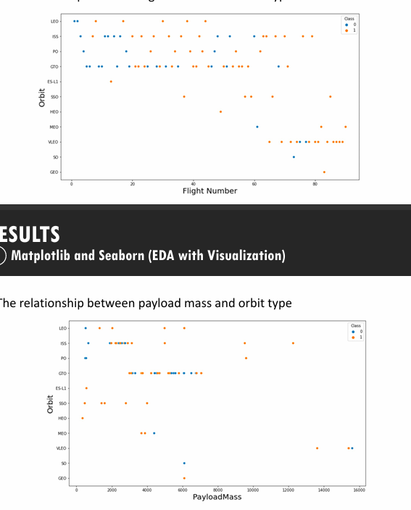
EDA with Data Visualization
• The relationship between flight number and orbit type

Slide 22
EDA with Data Visualization
• The relationship between payload mass and orbit type

Slide 23
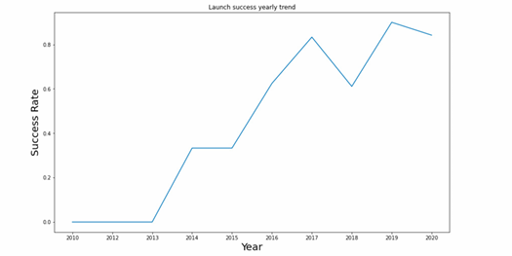
EDA with Data Visualization
• The launch success yearly trend

Slide 24
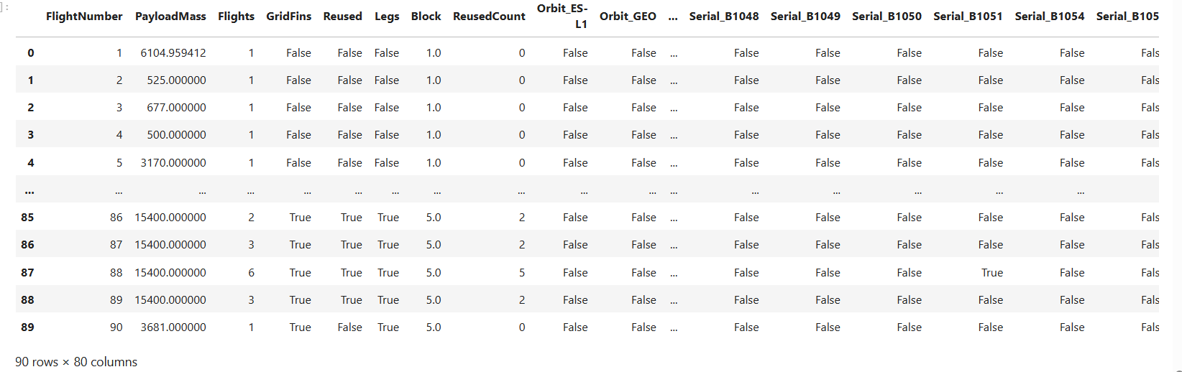
EDA with Data Visualization
Features Engineering : Creation of dummy variables to categorical columns
https://github.com/LahcenAmroune/Applied-Data-Science-Capstone/blob/main/edadataviz.ipynb

Slide 25
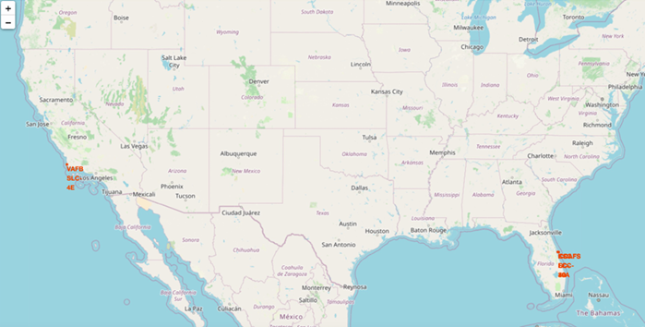
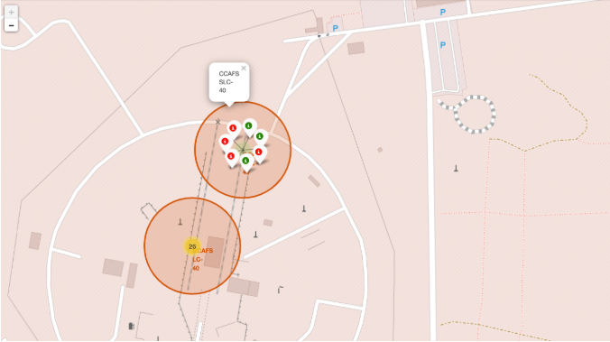
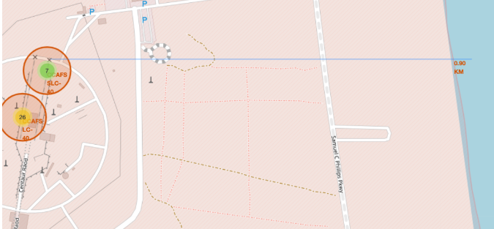
Interactive Visual Analytics with Folium
identify spatial patterns, the following geographic features were plotted on a map of launch sites:
All Launch Sites
Successful and Failed Launches
Distances between a launch site and proximate landmarks
Geographic analysis was conducted by visualizing launch site coordinates, mission outcome distributions, and distances to key landmarks on an interactive map.
https://github.com/LahcenAmroune/Applied-Data-Science-Capstone/blob/main/lab_jupyter_launch_site_location.ipynb

Slide 26
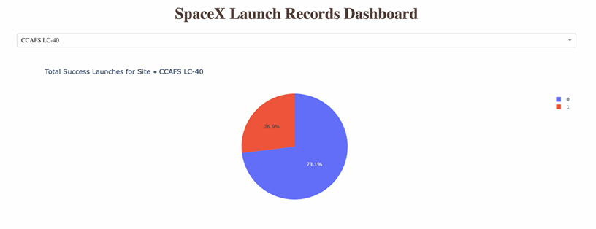
Interactive Visual Analytics and Dashboard
The figure below presents a pie chart illustrating the launch outcomes for site CCAFS LC-40, where 0 denotes failed launches and 1 denotes successful launches. As shown, 73.1% of launches from this site resulted in failure.
The pie chart below visualizes the outcome distribution for CCAFS LC-40, with failure represented by 0 and success by 1. Notably, the majority of launches—73.1%—from this site were unsuccessful.

Slide 27
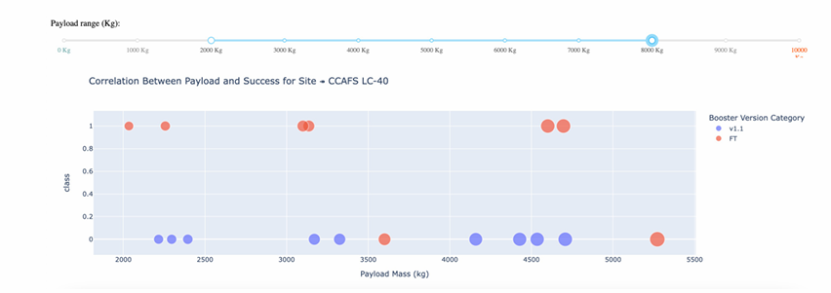
Interactive Visual Analytics and Dashboard
• The picture below shows a scatterplot when the payload mass range is set to be from 2000kg to 8000kg.
• Class 0 represents failed launches while class 1 represents successful launches.
https://github.com/LahcenAmroune/Applied-Data-Science-Capstone/blob/main/spacex-dash-app.py

Slide 28
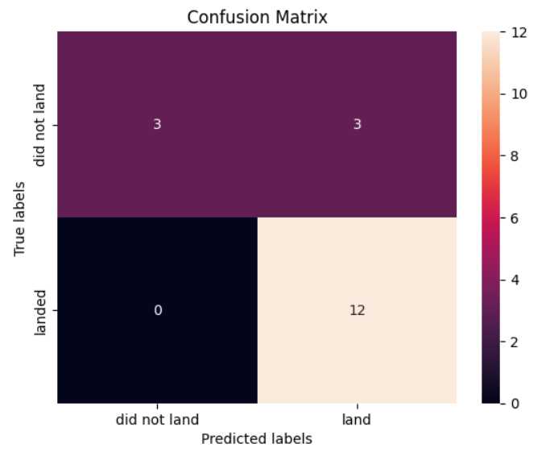
Machine Learning Prediction
Logistic regression
GridSearchCV best score: 0.8464285714285713
Accuracy score on test set: 0.8333333333333334
Confusion matrix:

Slide 29
Machine Learning Prediction
Support Vector Machine (SVM)
GridSearchCV best score: 0.8482142857142856
Accuracy score on test set: 0.8333333333333334
Confusion matrix:

Slide 30
Machine Learning Prediction
Decision Tree
GridSearchCV best score: 0.8892857142857142
Accuracy score on test set: 0.8333333333333334
Confusion matrix:

Slide 31
Machine Learning Prediction
K nearest neighbors (KNN)
GridSearchCV best score: 0.8482142857142858
Accuracy score on test set: 0.8333333333333334
Confusion matrix:
https://github.com/LahcenAmroune/Applied-Data-Science-Capstone/blob/main/SpaceX_Machine%20Learning%20Prediction_Part_5.ipynb

Slide 32
Discussion
Despite all four models—Logistic Regression, SVM, Decision Tree, and KNN—achieving identical test-set accuracy (83.3%) and confusion matrices, their performance diverged under hyperparameter tuning. To establish a definitive ranking, we compared their respective GridSearchCV best scores. Ordered from highest to lowest, the results are as follows: Decision Tree (0.889), K-Nearest Neighbors (0.848), Support Vector Machine (0.848), and Logistic Regression (0.846). This places the Decision Tree as the optimal model after parameter optimization.
Success rates have shown a steady upward trajectory over time across all factors, reflecting ongoing incremental operational improvements and technological advancements. Performance varies by orbit, with ES-L1, SSO, HEO, and GEO consistently achieving successful outcomes. Launch site also proved to be a highly predictive factor, with KSC LC-39A emerging as the top performer, closely followed by CCAFS LC-40. Among the predictive models evaluated, most achieved acceptable accuracy in forecasting landing outcomes, with the DecisionTreeClassifier delivering the best performance overall, demonstrating high accuracy, precision, and recall.

Slide 33
Appendix
Data sources
r/SpaceX API Docs
List of Falcon 9 and Falcon Heavy launches – Wikipedia

Slide 34
Conclusion
In this project, we set out to predict whether the first stage of a given Falcon 9 launch would land successfully, in order to determine the cost of a launch. Each feature of a Falcon 9 launch, such as payload mass or orbit type, may affect the mission outcome in a certain way. Several machine learning algorithms were employed to learn patterns from past Falcon 9 launch data and produce predictive models that can be used to predict the outcome of future launches. Among the four algorithms tested, the Decision Tree Classifier performed the best.
Our analysis revealed that success rates have increased over time across all factors, indicating continuous and incremental operational improvements and technological advancements. Different orbits exhibit varying success rates, with ES-L1, SSO, HEO, and GEO showing consistently successful outcomes. Launch site also proved to be a highly predictive factor, with KSC LC-39A being the top performer, closely followed by CCAFS LC-40.
Overall, many of the predictive models evaluated were able to predict landing outcomes with an acceptable level of accuracy. In the testing performed, the Decision Tree Classifier produced the best results, achieving high accuracy, precision, and recall.
If you'd prefer a shorter version, a bullet-point version, or a version that merges your original and new text differently, just let me know.

Slide 35
Thank you!
Presented by Lahcen Mokhtar AMROUNE • July 2026 Data Science & Machine Learning Capstone | Applied Predictive Analytics

